Slide 1
OpenChain Monthly Meeting
Europe and Asia - 2025-06-18

Slide 2
Anti-Trust Policy Notice
Linux Foundation meetings involve participation by industry competitors, and it is the intention of the Linux Foundation to conduct all of its activities in accordance with applicable antitrust and competition laws. It is therefore extremely important that attendees adhere to meeting agendas, and be aware of, and not participate in, any activities that are prohibited under applicable US state, federal or foreign antitrust and competition laws.
Examples of types of actions that are prohibited at Linux Foundation meetings and in connection with Linux Foundation activities are described in the Linux Foundation Antitrust Policy available at http://www.linuxfoundation.org/antitrust-policy. If you have questions about these matters, please contact your company counsel, or if you are a member of the Linux Foundation, feel free to contact Andrew Updegrove of the firm of Gesmer Updegrove LLP, which provides legal counsel to the Linux Foundation.

Slide 3
Agenda
Project News
The OpenChain Steering Committee Meeting

Slide 4
Project News

Slide 5














1H 2025 Overview
New Platinum Member:
ISO/IEC 5230 Co-Announcements:
Recertification Co-Announcements:
ISO/IEC 18974 Co-Announcements:
Proposed updates to ISO/IEC 5230 and ISO/IEC 18974 finished public comments and freeze periods, moved to Steering Committee.
Maturity models released.
“Explainers” for company departments released.
Open source policy template updated.
Telco SBOM Quality Guide updated.
AI BOM Compliance Guide complete, board approval pending.
Cross-industry SBOM quality guide early drafting.
Reorganized reference library of 1,500~ resources. Better discoverability of processes
Improved integration with other LF Project activities (e.g. OpenSSF).

Slide 6

Welcome Our Latest Platinum Member!

Slide 7


25 Platinum Members (Governing Board)
Jimmy Ahlberg Ericsson
Members Represent Trillions In USD Market Value

Slide 8
S-Core Adopts ISO/IEC 18974
(They Adopted ISO/IEC 5230 in February)

Slide 9




Korean ISO/IEC 18974 Adoption Is Excellent!

Slide 10
OpenAnolis Adopts ISO/IEC 5230

Slide 11


Chinese Operating Systems Love OpenChain

Slide 12
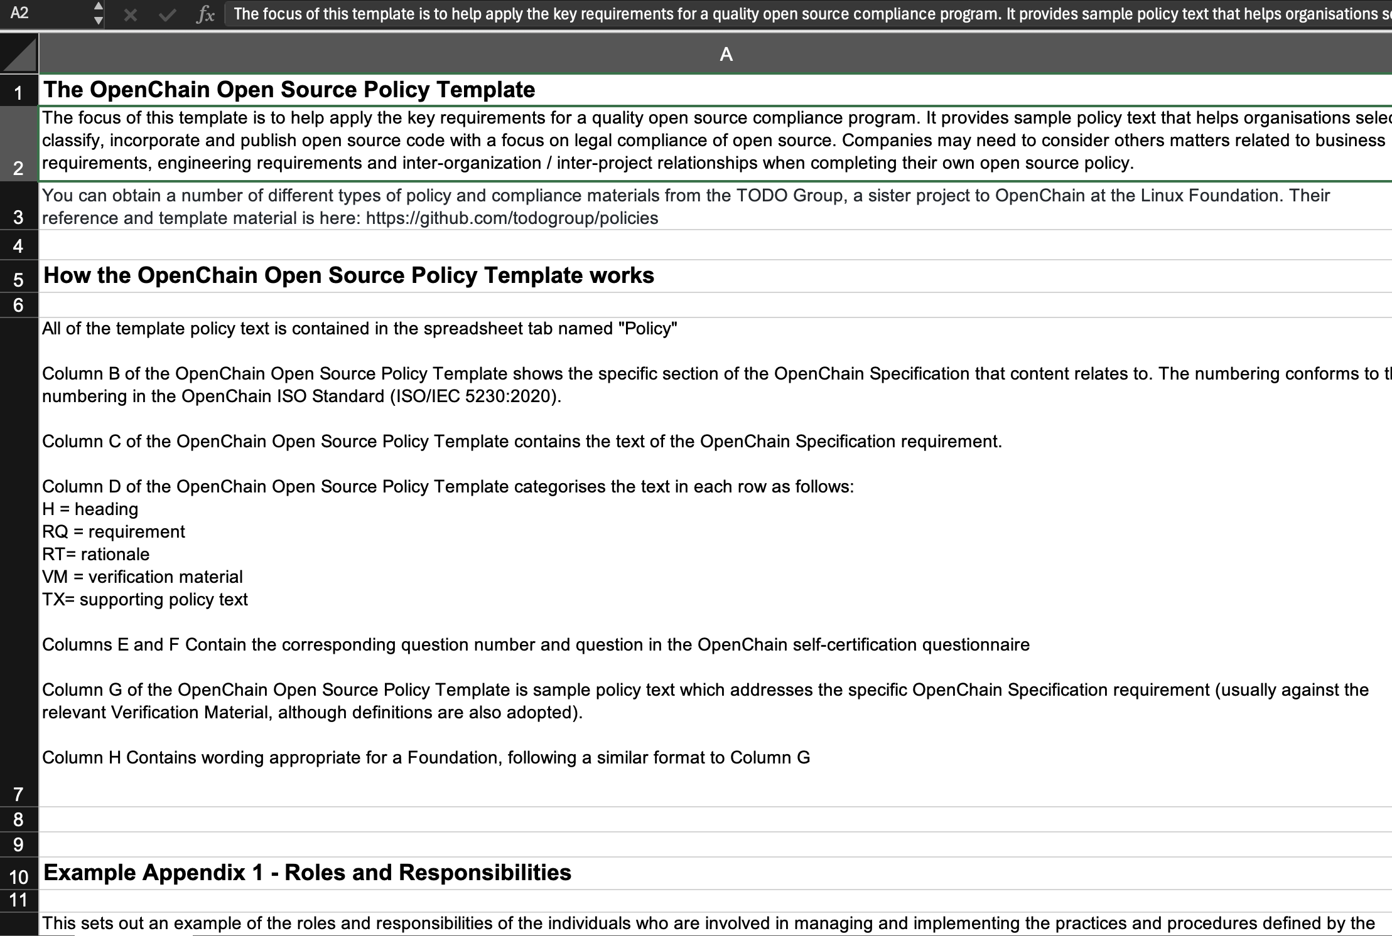
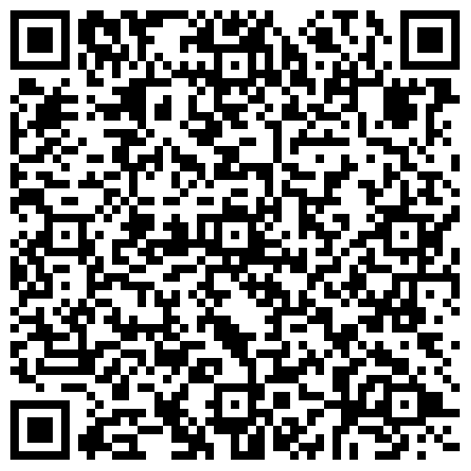
Updated Policy Template

Slide 13
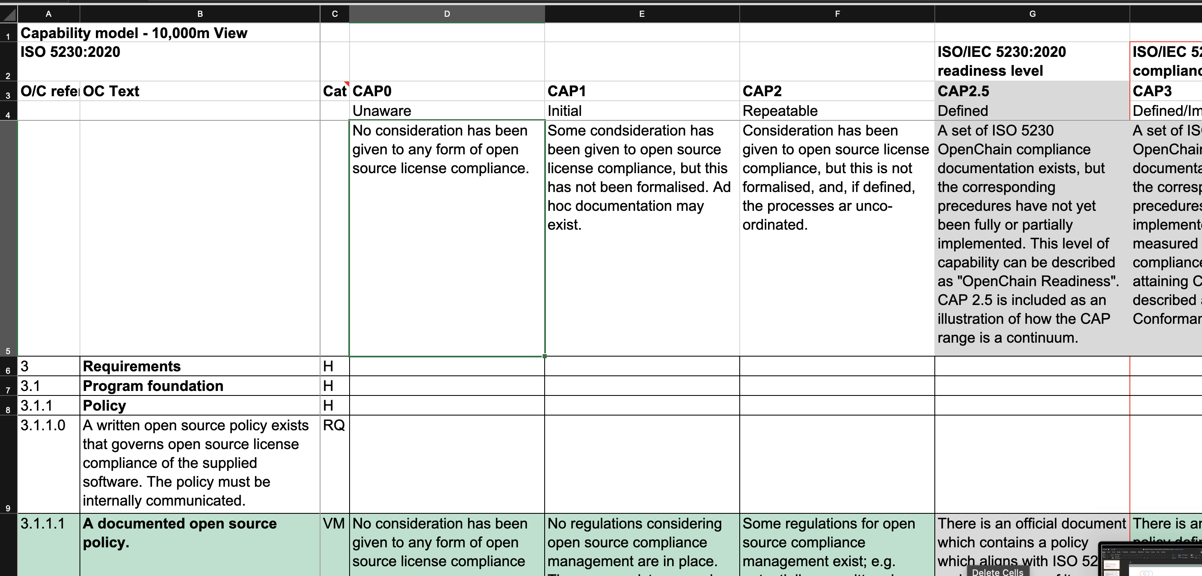
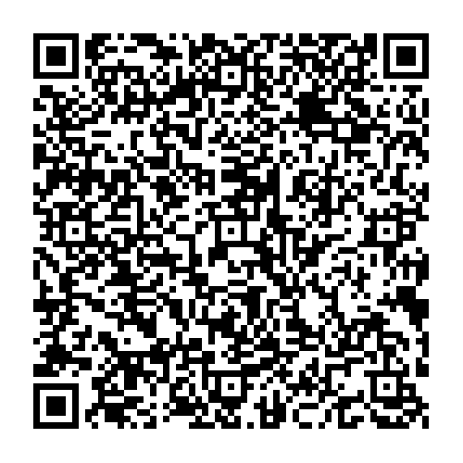
Updated Capability Model

Slide 14
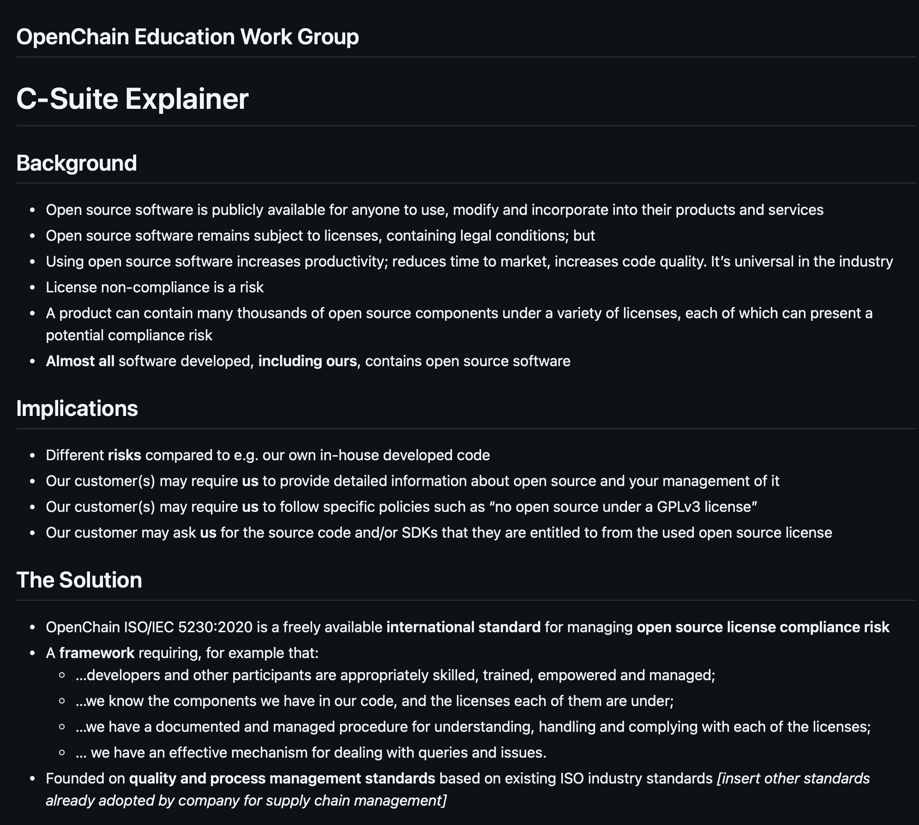
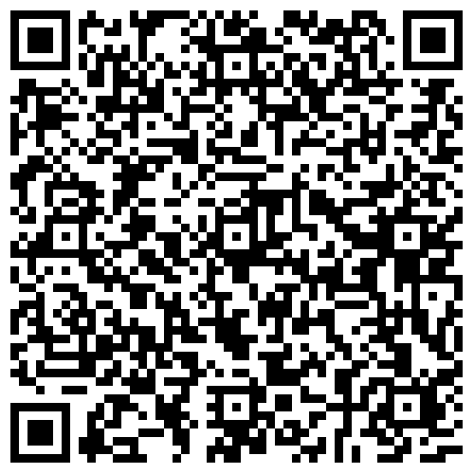
New Explainers

Slide 15
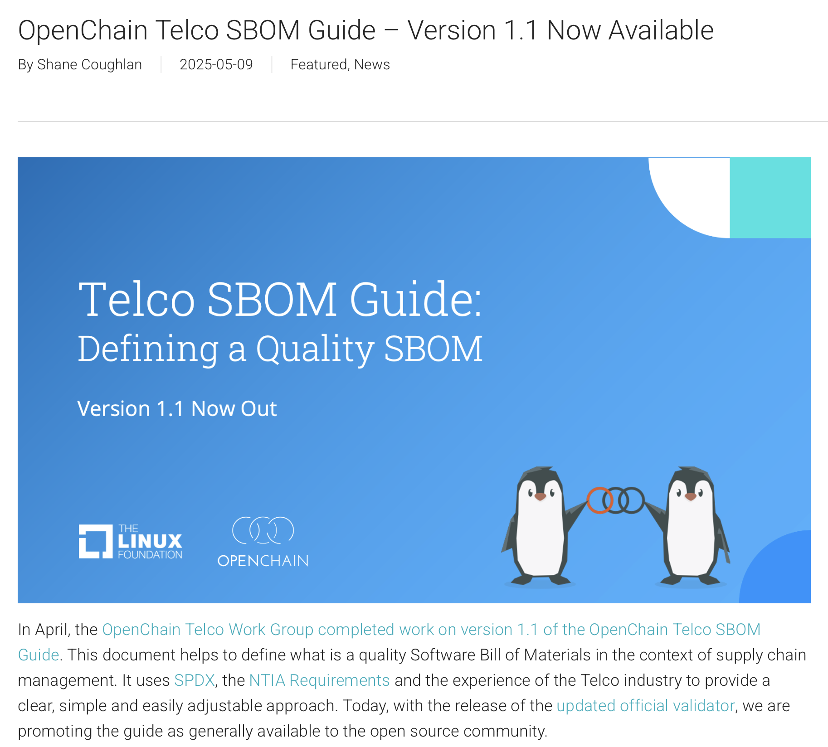
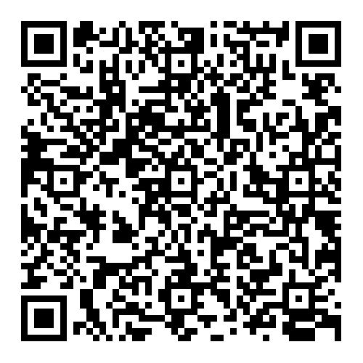
Updated Telco SBOM Quality Guide

Slide 16
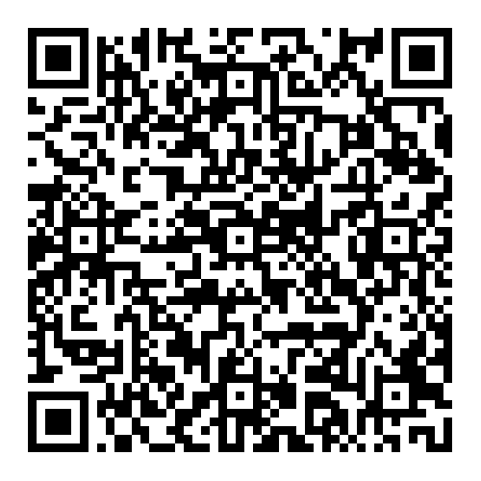
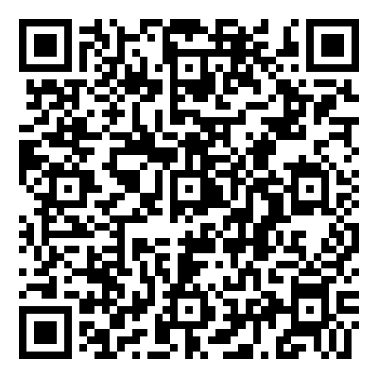
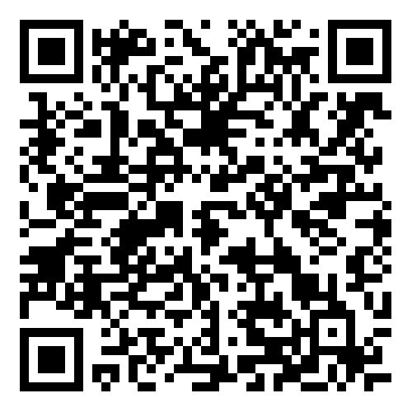
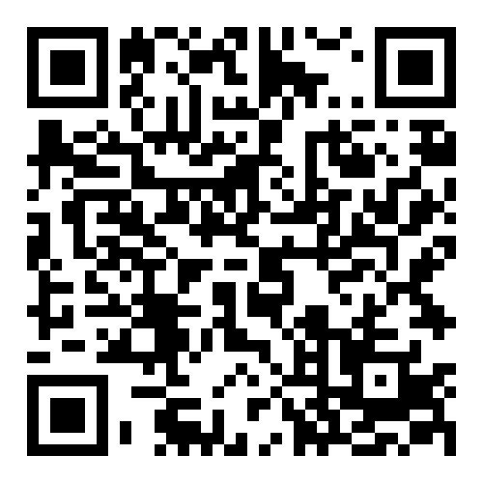
Telco SBOM Quality Work … EXPANDED
Official Validator
Third-Party Tooling
ByteDance Case Study
ByteDance Schemas

Slide 17
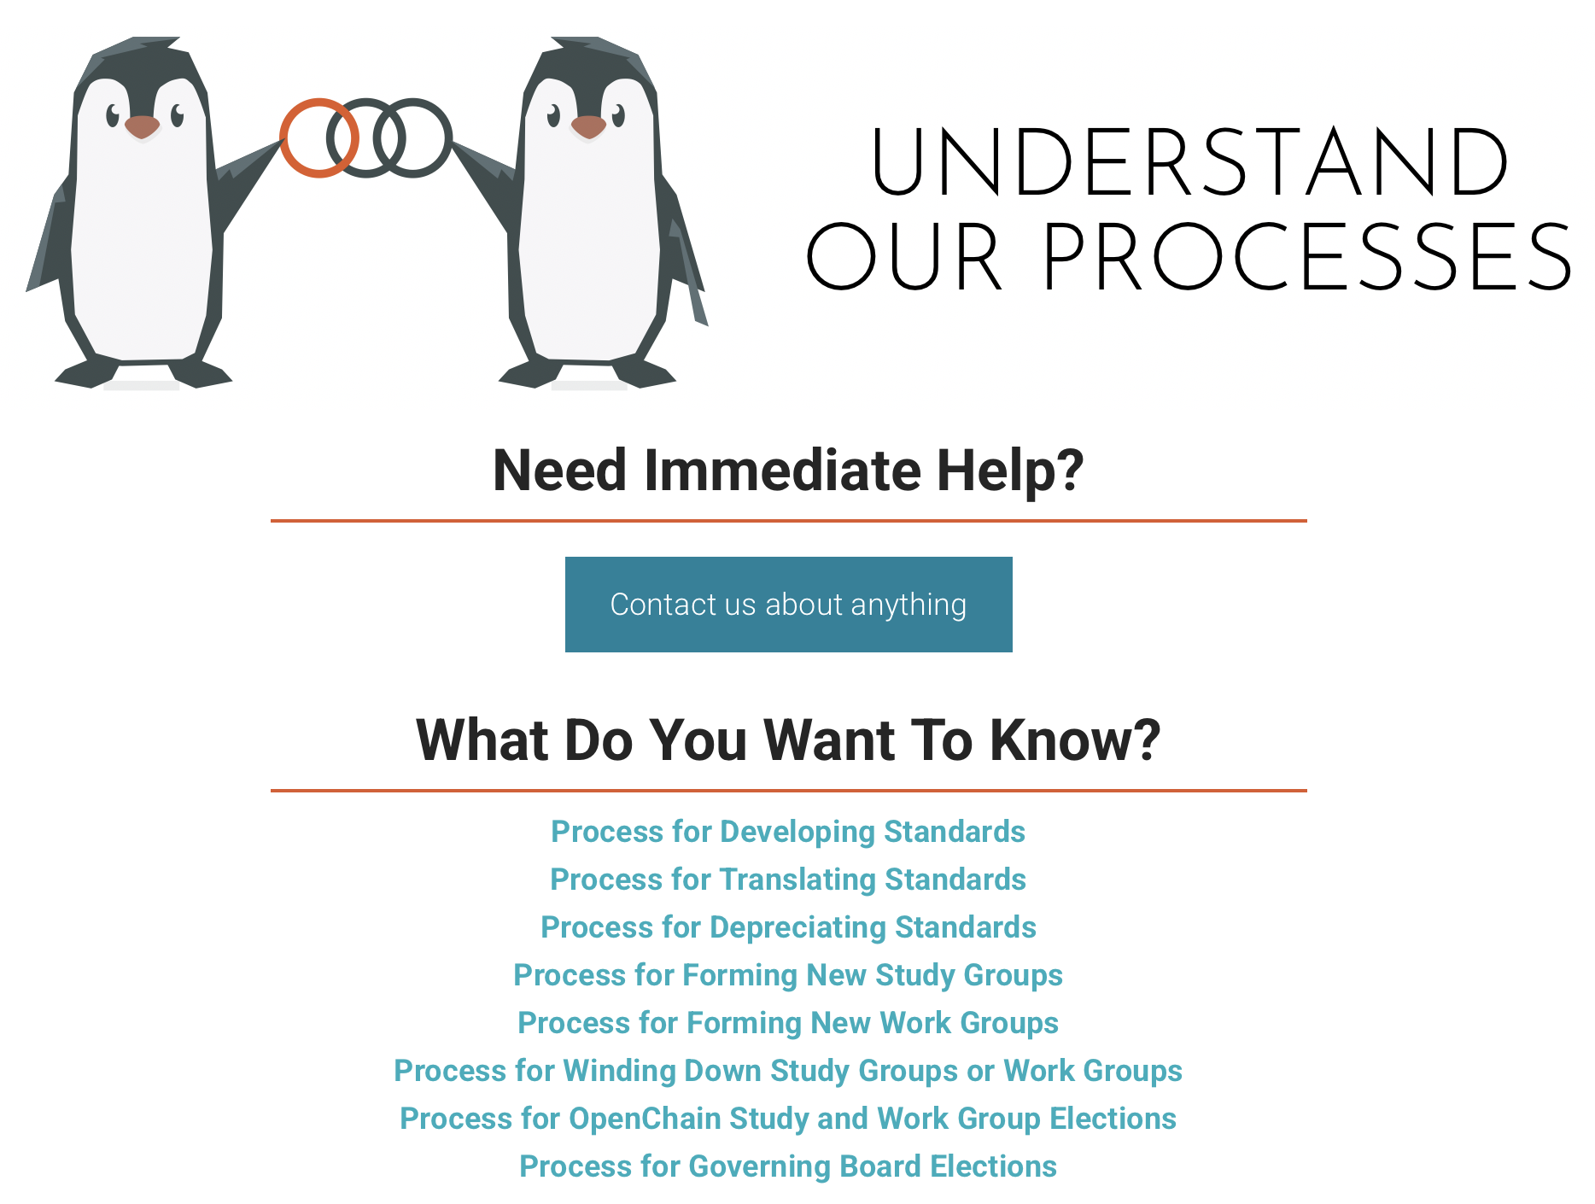
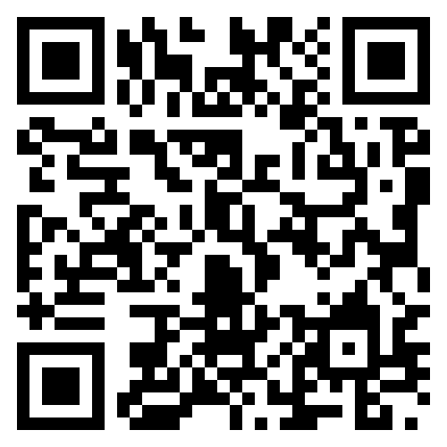
Easier To Find Our Processes

Slide 18
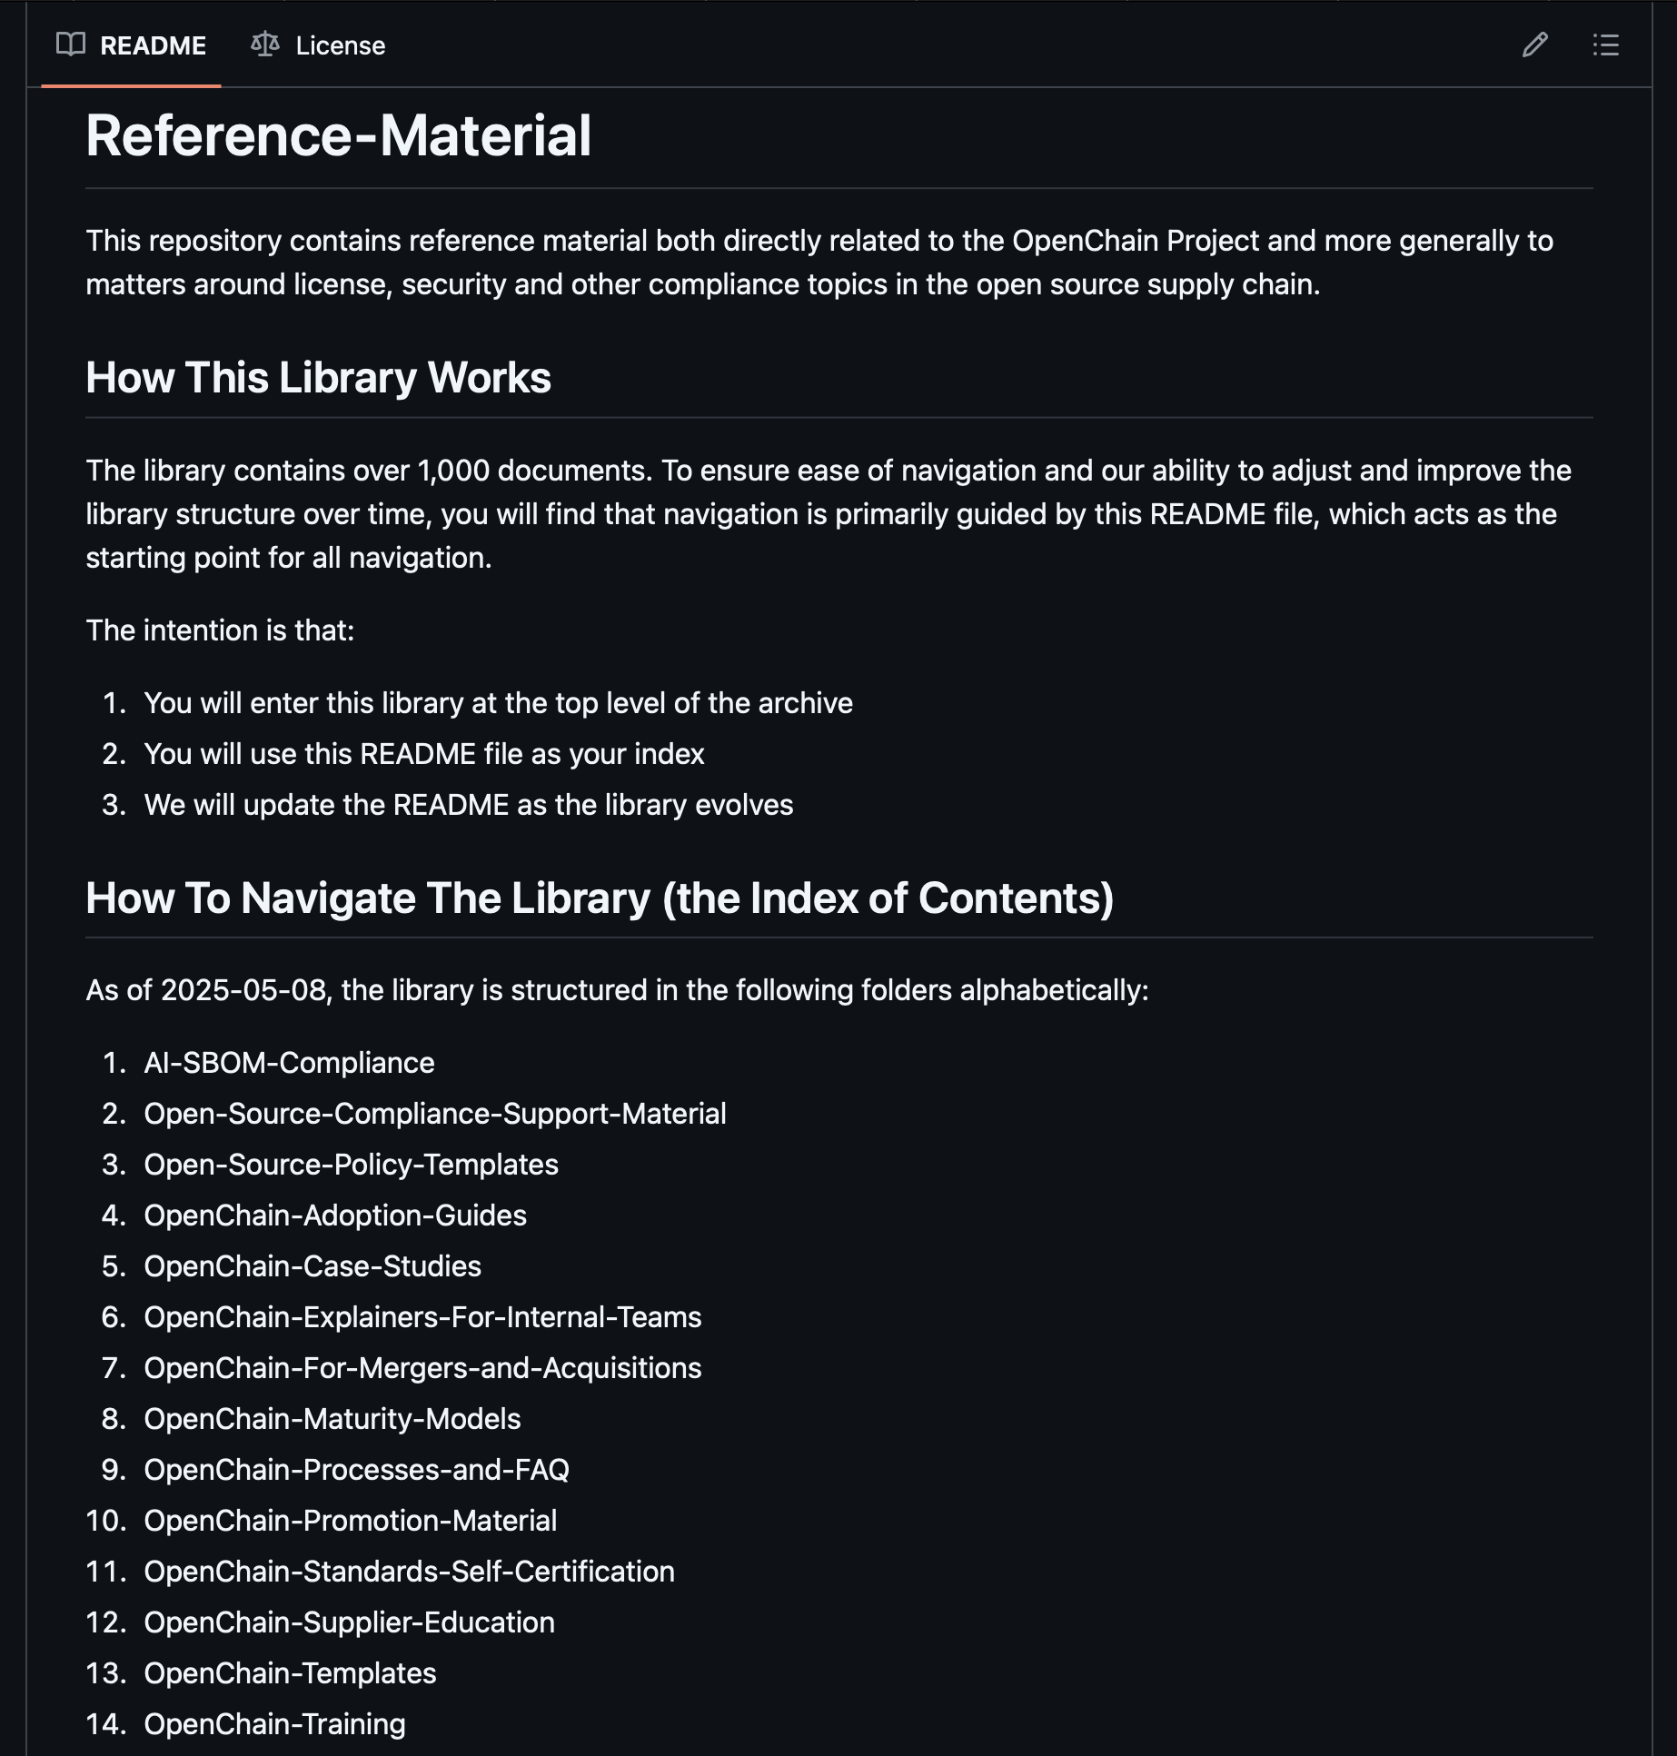
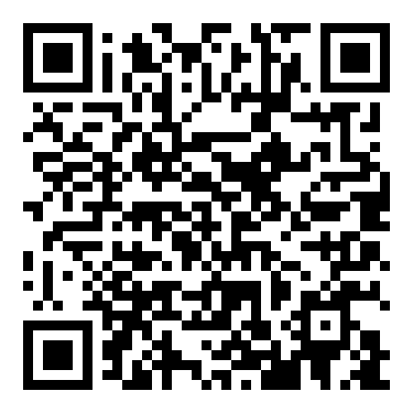
A Reorganized Library

Slide 19


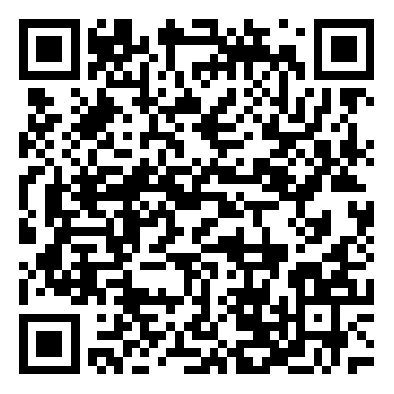
AI Compliance Draft Guide Ready
Dave Marr
Qualcomm
Matthew Crawford
Arm
We held our regular workshop for the OpenChain AI Work Group on May 6th. During this meeting some important decisions were made. The Work Group attendees agreed that initial drafting on the AI SBOM Compliance Guide is now substantially complete, and there will be two next steps:
Asking for formal approval to start a public comment period from the Governing Board today.
If approval is given, the guide will go into a six-week public comment period, and after that period will move into a publication process.
The Draft AI SBOM Compliance Guide:
https://docs.google.com/document/d/1XHztgMALwnu2D02bmWYyXeW3wE_Jw199/edit#heading=h.x3i92tls8mld
Last Meeting:

Slide 20
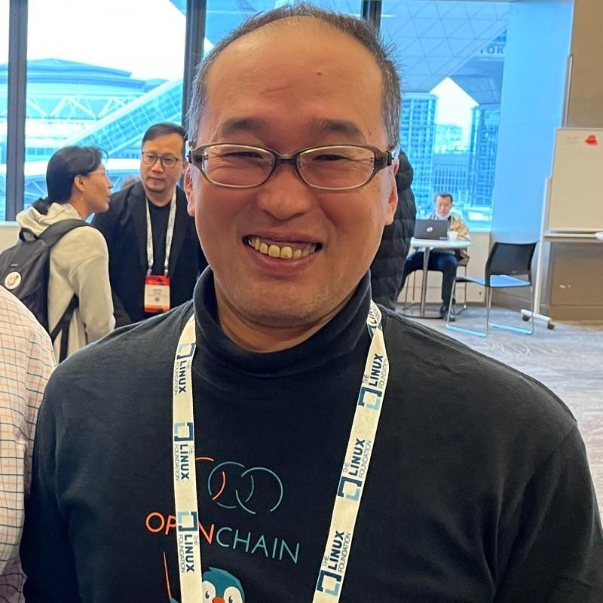
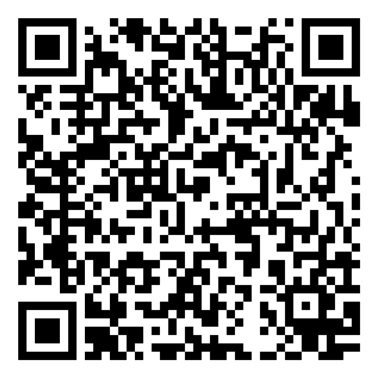
SBOM Study Group Update
Kobota San Sony
The SBOM Study Group has continued its discussion around SBOM Quality. There are two key items framing the discussion:
The release of Version 1.1 of the Telco SBOM Quality Guide: https://openchainproject.org/featured/2025/05/09/openchain-telco-sbom-guide-version-1-1-now-available
The development of a ”thinking” document considering how a cross-industry, cross-format SBOM quality could be structured: https://github.com/OpenChain-Project/SBOM-sg/blob/main/Cross-Industry-SBOM-Quality-Guide/en/Cross-Industry-SBOM-Quality-Guide.md
Last Meeting:

Slide 21
The OpenChain Steering Committee Meeting

Slide 22

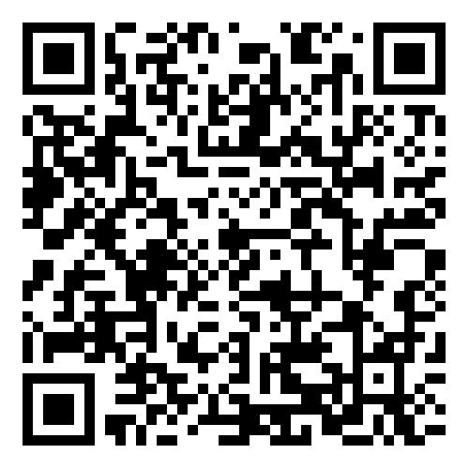
Proposed Updates To Our Existing Standards
Chris Wood Lockheed Martin
Suggestions for updates were collected over a 2-year period
There was a 6-month public comment period
There was a 3-month freeze period
The proposals will now go the Steering Committee on 2025-06-25 for review and formal decisions.

Slide 23
Review of suggested changes to ISO/IEC 5230
Current ISO standard:
https://github.com/OpenChain-Project/License-Compliance-Specification/blob/master/ISO-5230-2020/en/ISO-5230-2020.md
Current Next Generation Draft (pre-public comments period):
https://github.com/OpenChain-Project/License-Compliance-Specification/blob/master/3.0/en/openchain-license-compliance-3.0.md
All open issues have been closed by the Specification Work Group
https://github.com/OpenChain-Project/License-Compliance-Specification/issues?q=is%3Aissue+is%3Aclosed
Next:
The six month comment period and three month freeze period have been completed. It is up to the Steering Committee to decide if we proceed with the changes, and on what timescale.

Slide 24
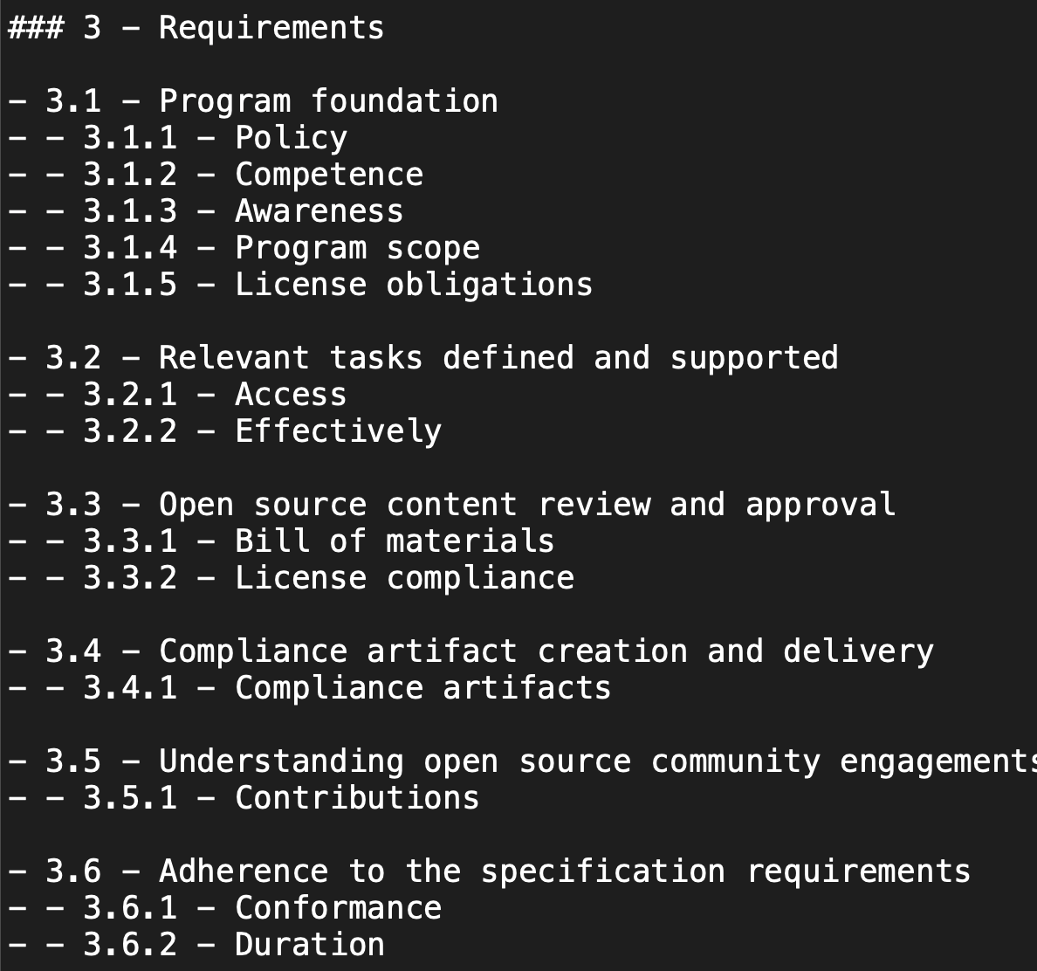
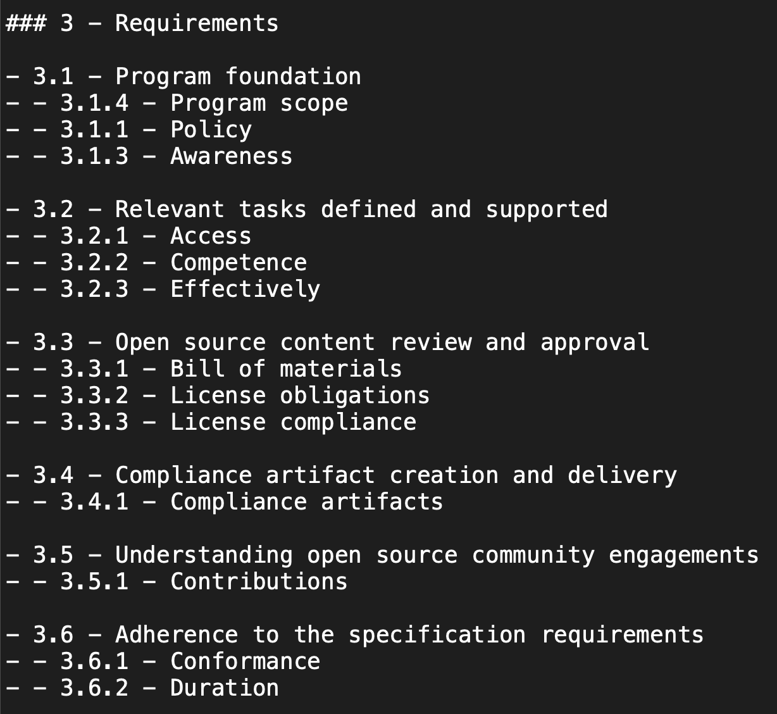
Suggestion #1 for ISO/IEC 5230:2020

Slide 25
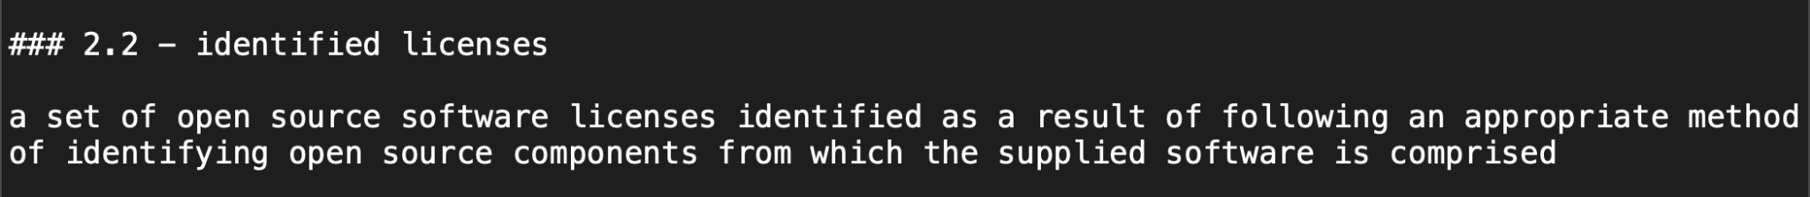
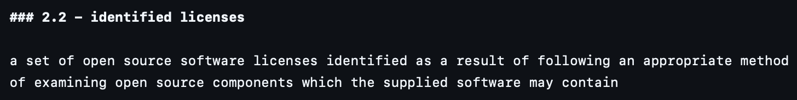
Suggestion #2 for ISO/IEC 5230:2020

Slide 26
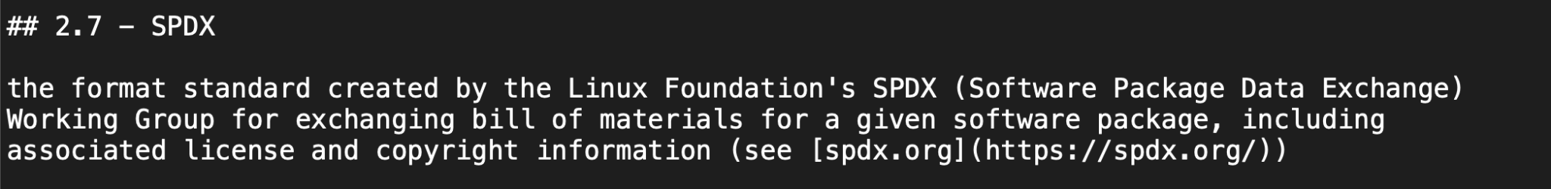
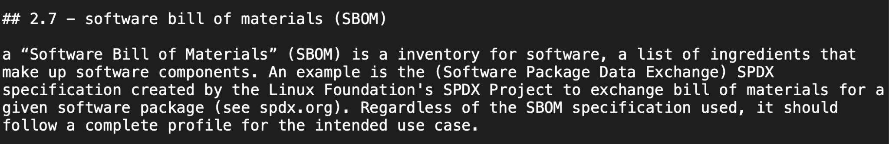
Suggestion #3 for ISO/IEC 5230:2020

Slide 27
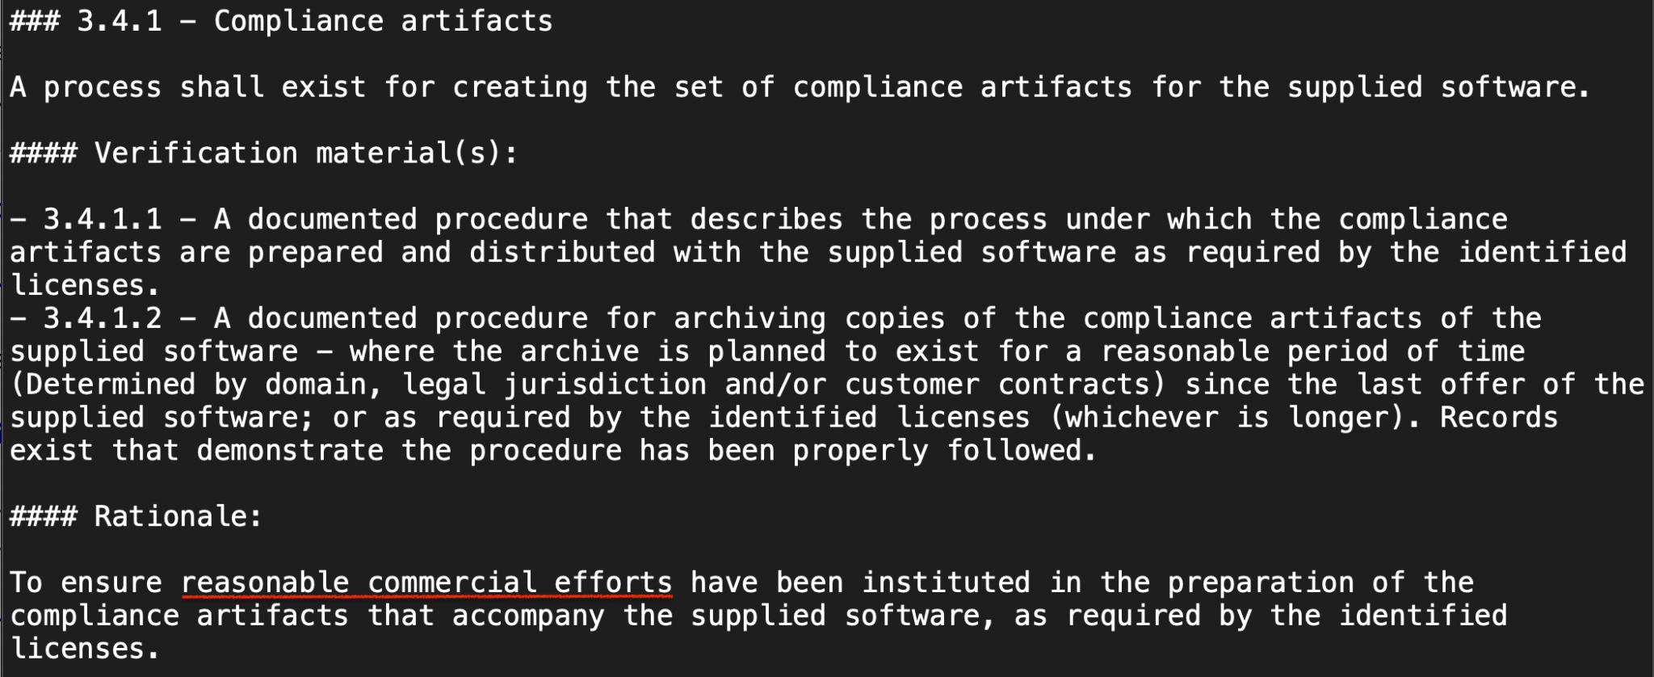
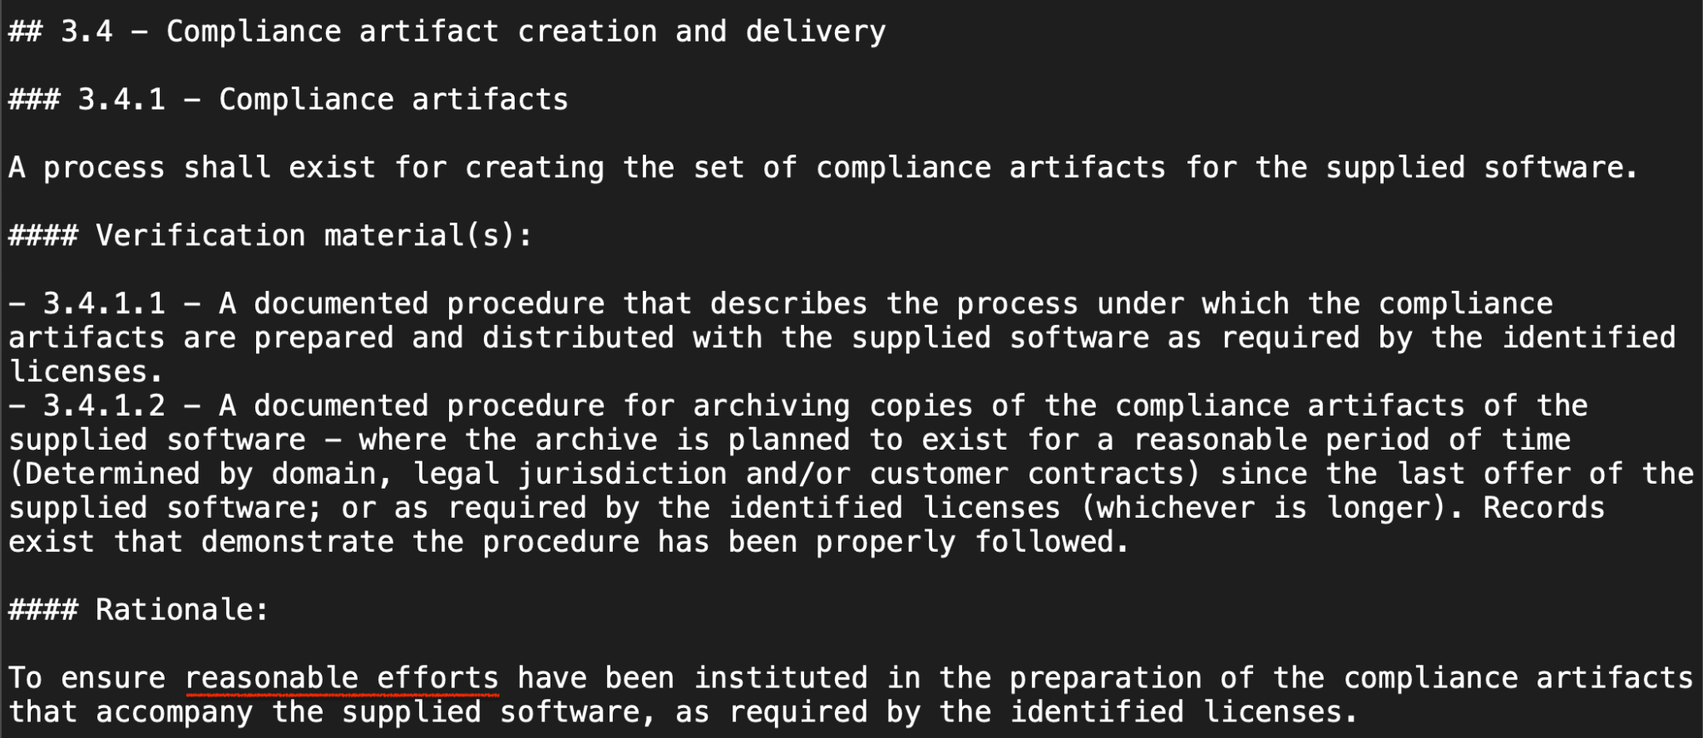
Suggestion #4 ISO/IEC 5230:2020

Slide 28
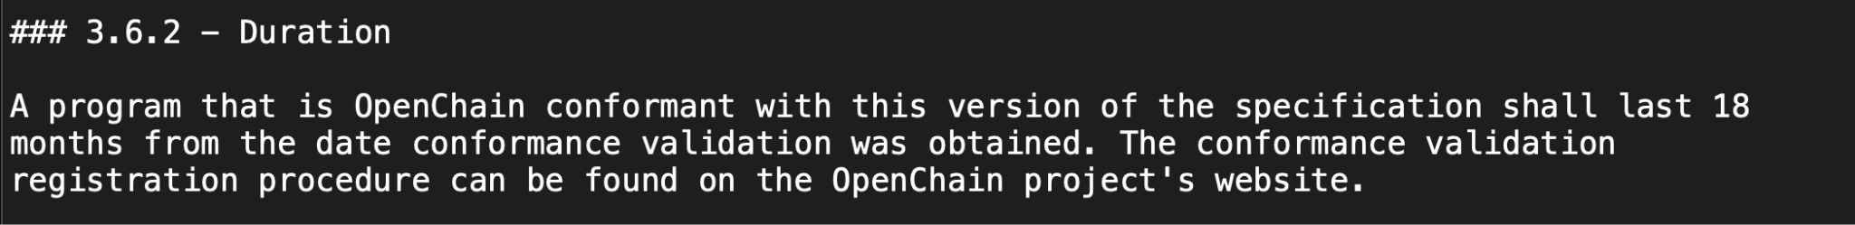
Suggestion #5 for ISO/IEC 5230:2020

Slide 29
Review of suggested changes to ISO/IEC 18974
Current ISO standard:
https://github.com/OpenChain-Project/Security-Assurance-Specification/blob/main/Security-Assurance-Specification/ISO-18974/en/ISO-18974.md
Current Next Generation Draft (pre-public comments period):
https://github.com/OpenChain-Project/Security-Assurance-Specification/blob/main/Security-Assurance-Specification/2.0/en/openchain-security-specification-2.0.md
All open issues have been closed by the Specification Work Group
https://github.com/OpenChain-Project/Security-Assurance-Specification/issues?q=is%3Aissue+is%3Aclosed
Next:
The six month comment period and three month freeze period have been completed. It is up to the Steering Committee to decide if we proceed with the changes, and on what timescale.

Slide 30
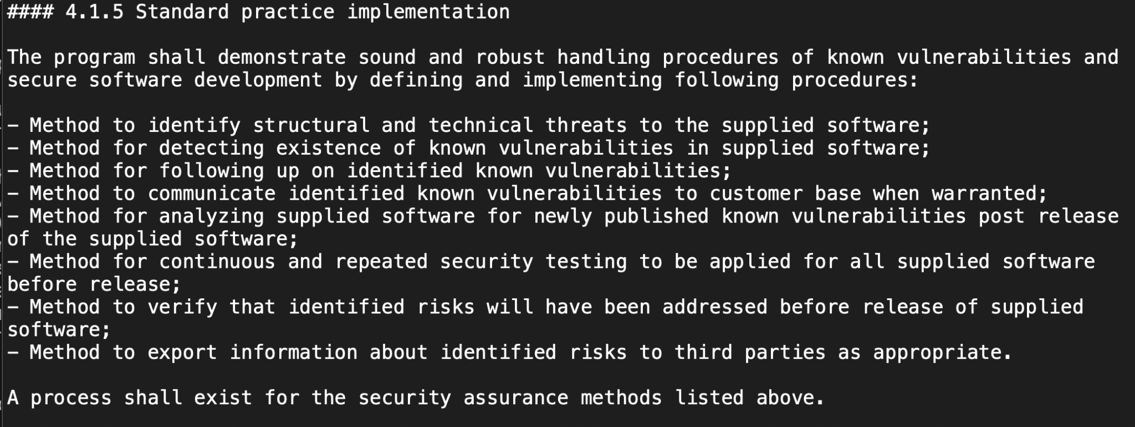
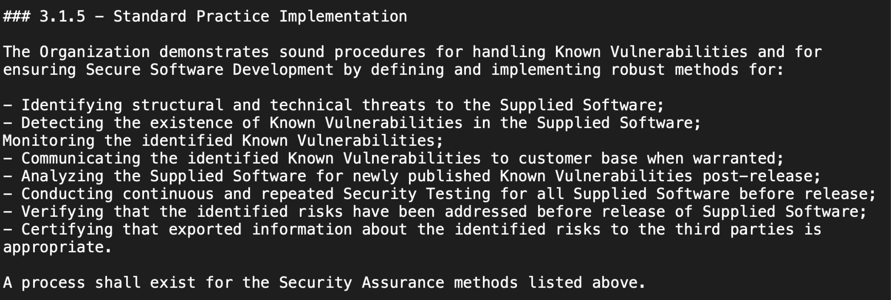
Suggestion #1 for ISO/IEC 18974:2023

Slide 31
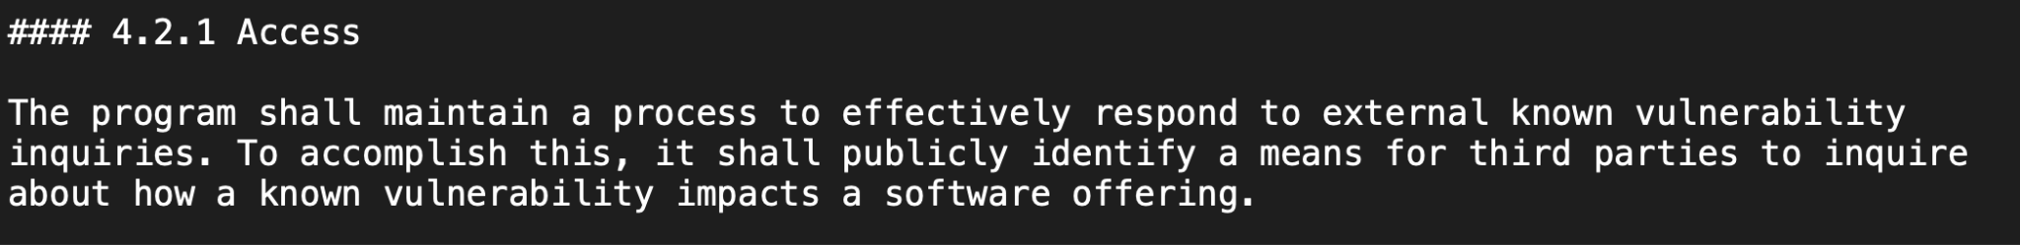
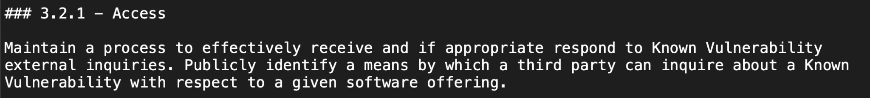
Suggestion #2 for ISO/IEC 18974:2023

Slide 32
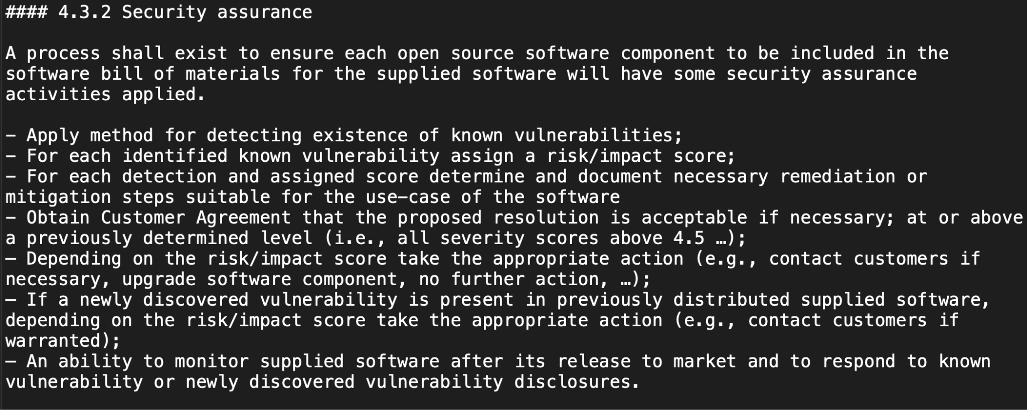
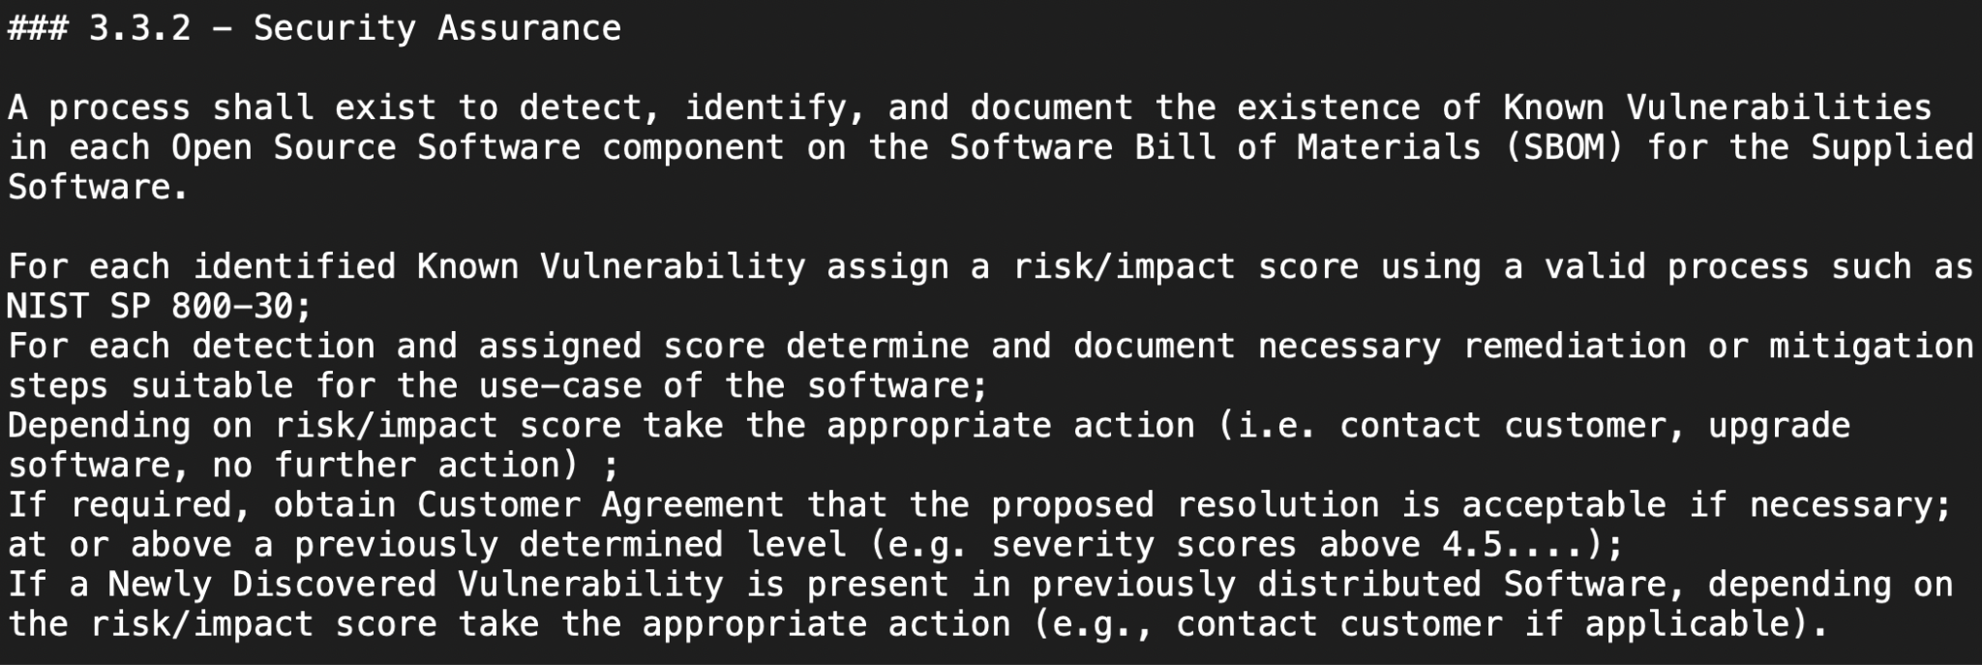
Suggestion #3 for ISO/IEC 18974:2023

Slide 33
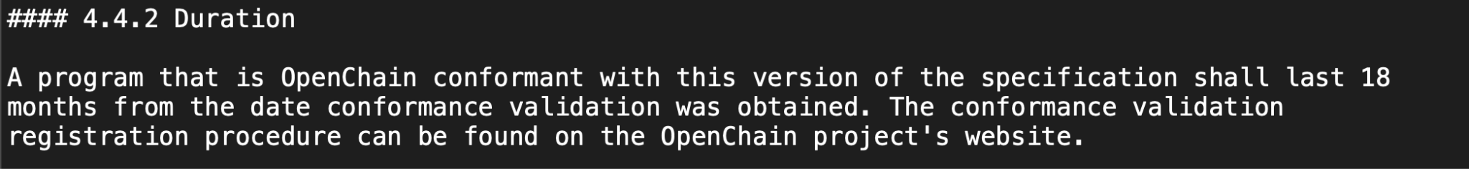
Suggestion #4 for ISO/IEC 18974:2023

Slide 34
Next Steps: Steering Committee on 2025-06-25
The Steering Committee will meet to discuss the proposed changes and make decisions about:
If the changes are accepted
When the changes (if accepted) will be included in updated versions of the standards

Slide 35
Question to the Community
Do you have questions around our submission for the Steering Committee?
Do you have any comments to add to the formal submission?
Do you have any other items you want them to discuss?

Slide 36
Any Other Business?

Slide 37
Close of meeting

Slide 38
See you next time!

